Slide 1

SAVEETHA INSTITUTE OF MEDICAL AND TECHNICAL SCIENCES, CHENNAI – 602 105
CAPSTONE PROJECT
TITLE
DESIGNING AND IMPLEMENTINN AUTOMATED SOFTWARE DEFINED DATA CENTER (SDDC) MANAGEMENT SYSTEM
Submitted to
SAVEETHA SCHOOL OF ENGINEERING
CSA1579-CLOUD COMPUTING AND BIG DATA ANALYTICS IN HEALTH CARE INDUSTRIES.
BY
M.SWETHA[192211983]

Slide 2

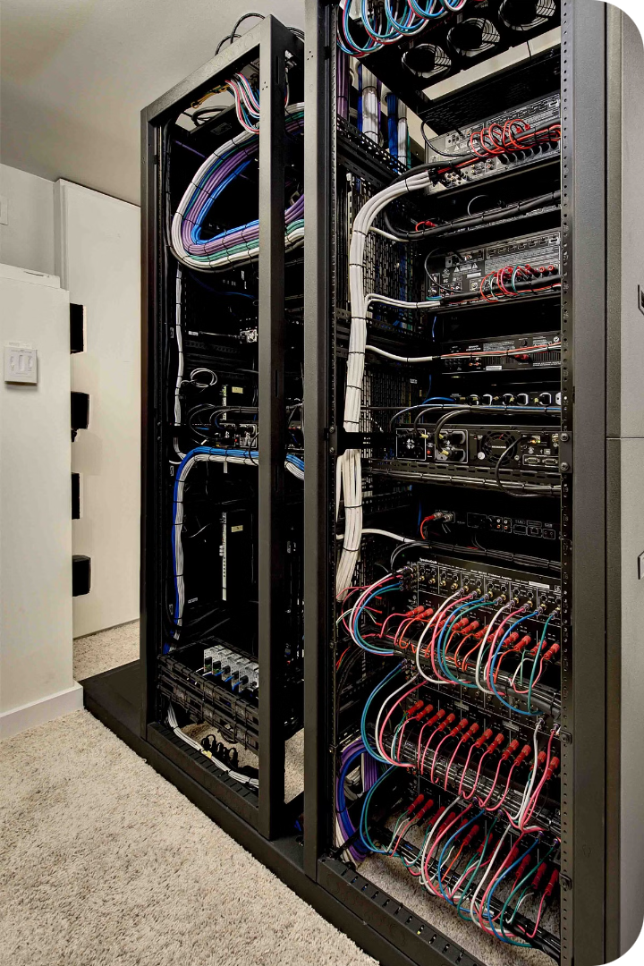
SDDC Management System
Automated SDDC Management System for efficient infrastructure management.
The SDDC Management System is a comprehensive solution designed to streamline the management of software-defined data centers. It leverages advanced automation and analytics to provide real-time visibility and control over the entire infrastructure.
Key features of the SDDC Management System include:
Automated provisioning and deployment of virtual resources
Intelligent monitoring and anomaly detection
Proactive optimization and resource allocation
Seamless integration with existing IT systems

Slide 3
Abstract
This innovative SDDC management system automates key lifecycle processes, enhancing operational efficiency and minimizing the risk of human error.
Automation
Scalability
By automating repetitive tasks, the system reduces the potential for manual mistakes and streamlines daily operations.
The system dynamically adjusts resource allocation to match fluctuating demands, ensuring optimal performance at all times.
Self-healing
Security
Advanced diagnostics and self-correction capabilities enable the system to autonomously detect and resolve issues, minimizing downtime.
Comprehensive policy enforcement and real-time threat monitoring safeguard the SDDC environment against potential security breaches.

Slide 4
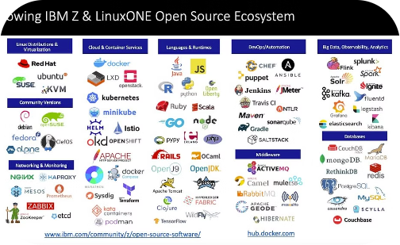
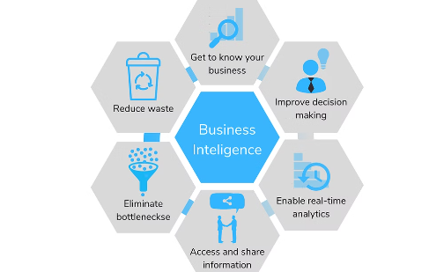
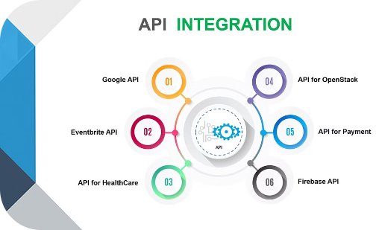
Materials and Methods
Open Source Tools
Commercial Solutions
API Integration
Ansible, Kubernetes, and OpenStack power the automated provisioning, containerization, and orchestration of the SDDC infrastructure.
VMware vCenter, Microsoft Azure, and AWS provide the virtualization management, hybrid cloud deployments, and cloud-based services that complement the open-source foundation.
The system seamlessly integrates with existing monitoring and logging tools, enabling real-time visibility, proactive troubleshooting, and intelligent maintenance of the SDDC infrastructure.

Slide 5




Design Overview
The system architecture focuses on modularity and scalability to support evolving SDDC needs.
Infrastructure Layer
Orchestration Layer
Management Layer
Physical and virtual resources
Automates provisioning and configuration
Monitors and controls infrastructure

Slide 6
Implementation Details
The system is developed using agile methodologies and follows best practices for software development.
Phase
Activities
Planning
Define requirements, design architecture
Development
Implement system components, test functionality
Deployment
Install and configure the system in the SDDC
Maintenance
Monitor performance, update software, troubleshoot issues

Slide 7

Conclusion and Future Applications
The SDDC Management System has proven to be a highly effective solution for optimizing SDDC infrastructure. By automating key tasks, the system has enabled organizations to achieve greater agility, scalability, and efficiency.
As the SDDC landscape evolves, the system's capabilities will expand. Future developments include cloud integration, enhanced security, data analytics, and AI-powered automation. These advancements will keep the system at the forefront of data center optimization, helping organizations adapt to the dynamic IT infrastructure landscape.

Slide 8
Benefits and Challenges
The SDDC Management System delivers significant benefits that improve operational efficiency and reduce costs. By automating provisioning, configuration, and resource allocation, the system increases agility and scalability. It also enhances reliability through self-healing capabilities that detect and resolve issues automatically. Additionally, the system's robust security features help safeguard the SDDC infrastructure against potential threats.
However, the implementation of this comprehensive system does present some challenges that must be addressed. Integrating the system with existing monitoring and logging tools can require complex configuration and customization. Maintaining the security of the SDDC environment is an ongoing concern, as the system must continuously evolve to keep pace with emerging threats. Finally, the long-term maintenance of the system, including software updates and troubleshooting, requires dedicated resources and expertise.

Slide 9




Future Directions
The system will be continuously enhanced to meet emerging SDDC trends and requirements.
Cloud Integration
Enhanced Security
Data Analytics
AI-Powered Automation
Seamlessly integrate with public and private clouds
Implement advanced security measures to protect data
Leverage data analytics to optimize performance and resource utilization
Utilize AI for predictive maintenance and self-healing capabilities

Slide 10
References
Explore industry standards and best practices for SDDC (Software-Defined Data Center) management and monitoring. This includes reviewing guidelines and recommendations from organizations like the DMTF (Distributed Management Task Force) and SDDC Working Group.
Research open-source and commercial tools that integrate with the SDDC architecture, such as Kubernetes, OpenStack, VMware vSphere, and Microsoft Azure Stack. Evaluate their features, capabilities, and compatibility with the existing infrastructure.
Review case studies of successful SDDC implementations across different industries to understand the challenges, best practices, and lessons learned. This will help inform the planning and deployment of the SDDC Management System.
Consult technical documentation and whitepapers from leading cloud and virtualization providers, such as AWS, Google Cloud, and IBM Cloud, to stay up-to-date with the latest SDDC technologies and trends.

